Slide 1
Introduction to Computer Programming Lecture 3.2:
Data Structures
Hemma Philamore
Department of Engineering Mathematics

Slide 2
Introduction to Computer Programming Lecture 3.2.a:
Data Structures: Lists
Hemma Philamore
Department of Engineering Mathematics

Slide 3
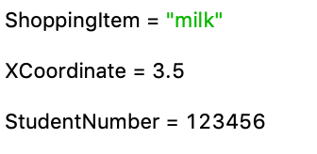

Limitations of simple variables
What if we need to deal with more complex data?
milk
butter
bread
eggs
John Doe
+555 7782
Sarah Moor
+555 4039
1
4
-3
0
Mary Salt
+555 9993
3
7
-4
1
Kent Low
+555 1234
0
0
1
-1

Slide 4
Learning Objectives
Data Structures
Lists
Tuples
Sets
Dictionary
Trees
Hash Tables
Queues
…

Slide 5
Why use different data structures
Why would you need more than lists?
Different problems, need different solutions!
Telephone Book
List 1
List 2
Dictionary
1
John Doe
1
+555 7782
John Doe
+555 7782
2
Sarah Moor
2
+555 4039
Sarah Moor
+555 4039
3
Mary Salt
3
+555 9993
Mary Salt
+555 9993
4
Kent Low
4
+555 1234
Kent Low
+555 1234

Slide 6
Learning Objectives
Data Structures
Lists
Tuples
Sets
Dictionary

Slide 7
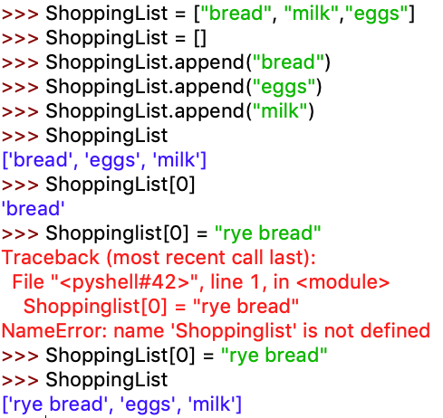
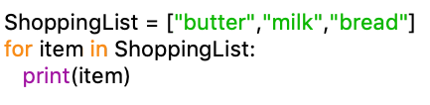
Lists
Initialise with no elements
add to the
end of the list
access
individual items
edit (mutable),
i.e. items can
be changed
you easily loop
through a list
(it’s “iterable”)

Slide 8
Nested Lists
List of lists
List
List
Name
Grade
passed syntax test
0
John Doe
68
No
1
Sarah Lee
75
Yes
StudentList[1][0]
2
Mary Moe
95
Yes
3
Kent Low
70
Yes
0
1
2

Slide 9
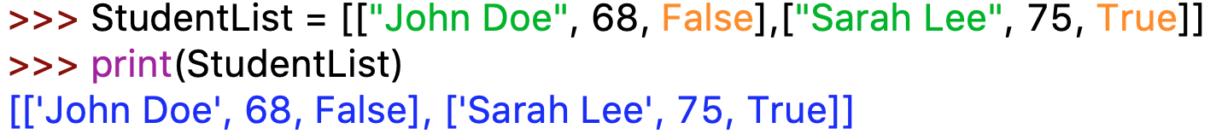
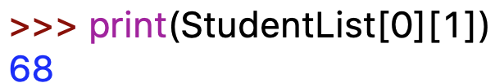
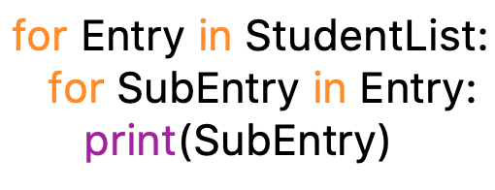

Nested Lists
“nested“ index
nested loops
Python lets you append anything.
You have to check as programmer!
Notes:
Edit as forgot to move over to Spyder

Slide 10
Nested Lists
Application: Matrix
0
1
2
3
1
4
-3
MyMatrix[1][2]
0
0
1
3
7
-4
1
2
0
0
1
-1
3
1
-1
0
0
MyMatrix.append([9,-2,0,1])
9
-2
0
1

Slide 11
Nested Lists
Application: Matrix
>>> for Row in MyMatrix:
print(Row)
[1, 4, -3, 0]
[3, 7, -4, 1]
[0, 0, 1, -1]
[1, -1, 0, 0]
>>> for Row in MyMatrix:
for Item in Row:
print(Item)
1
4
-3
0
3
7
-4
.
.
.

Slide 12
Introduction to Computer Programming Lecture 3.2.b:
Data Structures: List Comprehensions
Hemma Philamore
Department of Engineering Mathematics

Slide 13
List Comprehensions
Elegant way to create lists from sequences (rule-based).
Make lists where each element is the result of some operations applied to each member of the sequence.
Create a subsequence of those elements that satisfy a certain condition.

Slide 14
List comprehension is surrounded by brackets.
Instead of the list of data inside it, enter an expression followed by for loop and if-else clauses.
>>> # define a range
>>> xRange = [x for x in range(10)]
>>> print(xRange)
[0, 1, 2, 3, 4, 5, 6, 7, 8, 9]
print(type(xRange))
list
>>> # let the range start at 1
>>> xRange = [x+1 for x in range(10)]
>>> print(xRange)
[1, 2, 3, 4, 5, 6, 7, 8, 9, 10]

Slide 15
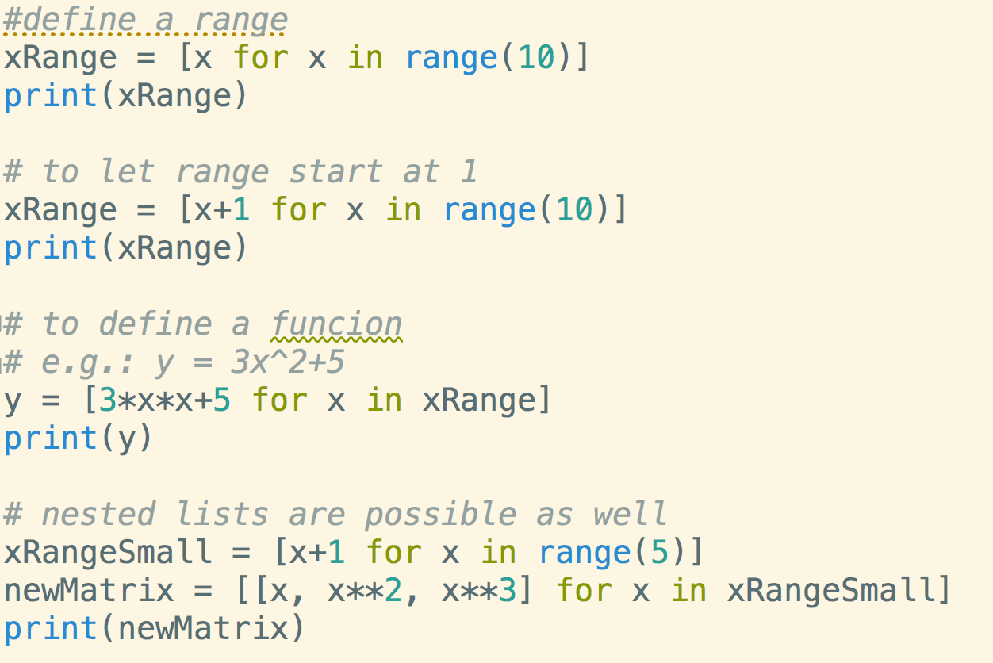
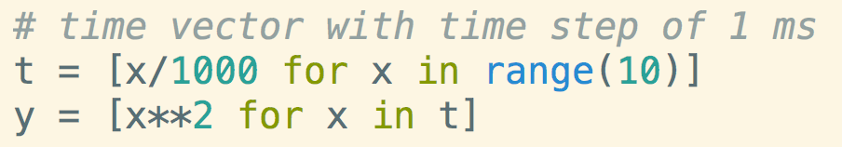
List Comprehensions
any offset is possible
time vector for plotting

Slide 16
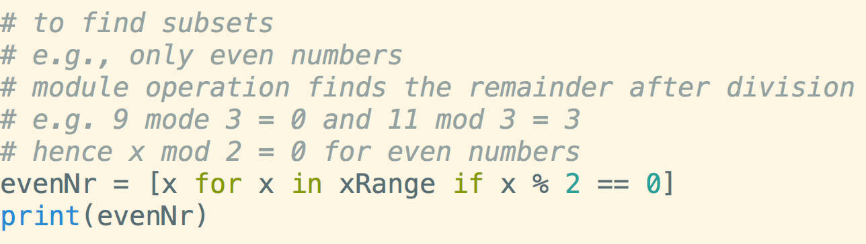
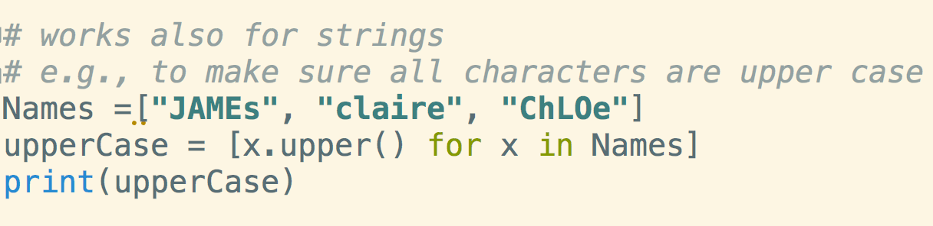
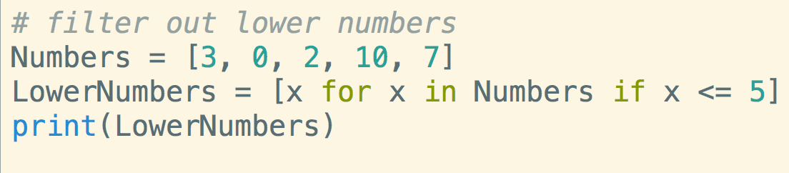
List Comprehensions
How would you get odd only numbers?
Can also work as a filter

Slide 17
Introduction to Computer Programming Lecture 3.2.c:
Data Structures: Tuples
Hemma Philamore
Department of Engineering Mathematics

Slide 18
Learning Objectives
Data Structures
Lists
Tuples
Sets
Dictionary

Slide 19

Tuples
Like lists, tuples are sequences of ’boxes’ that store data.
Unlike lists, tuples are immutable (can not be changed)
round brackets
constant values
immutable
Note: Tuples are lists with functionality removed — why do this?
It is an example of syntactic salt — “a feature designed to make it harder to write bad code”.

Slide 20
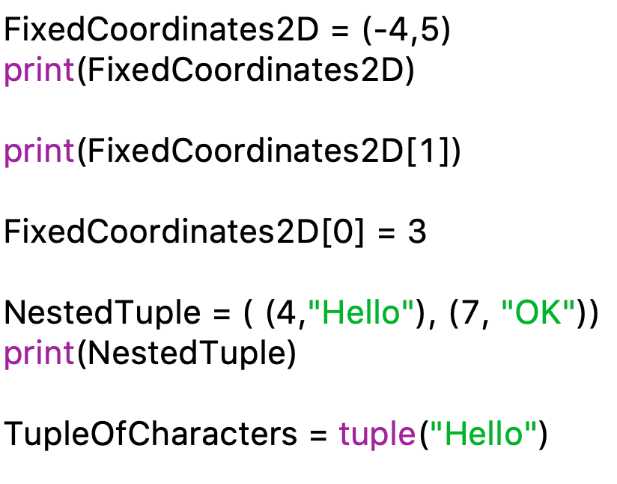
Tuples
access item with
squared brackets
produces
error immutable
casting works
here as well

Slide 21
Introduction to Computer Programming Lecture 3.2.d:
Data Structures: Sets
Hemma Philamore
Department of Engineering Mathematics

Slide 22
Learning Objectives
Data Structures
Lists
Tuples
Sets
Dictionary

Slide 23

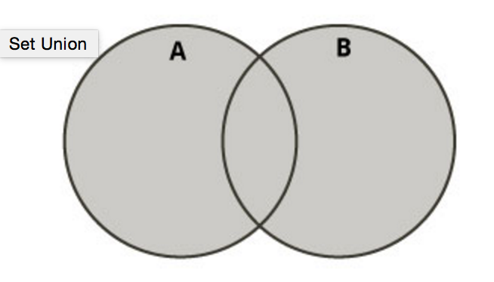

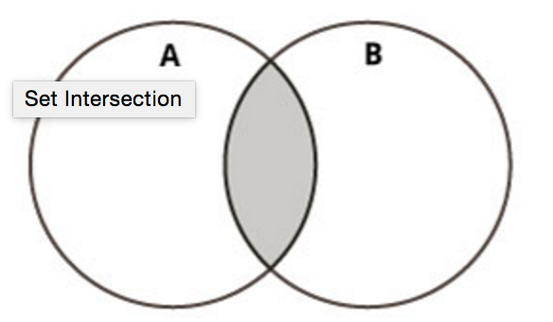

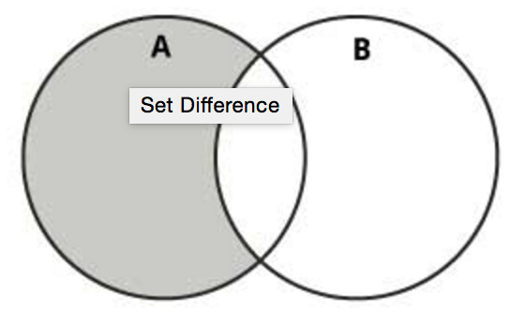

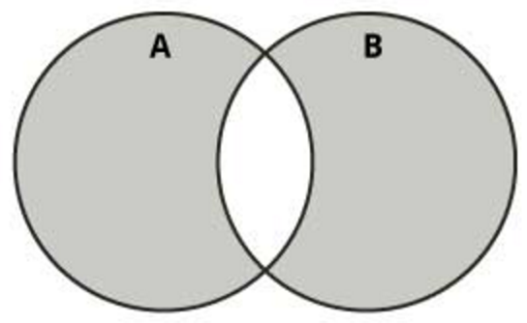

Sets
Sets are unordered collections with no duplicate elements.
You can test membership of a set (“is element in set”)
Supports mathematical operations
>>> SecondSet = {5, 4, 6}
union (|)
{1, 2, 8, 6, 7, 5, 4}
intersection (&)
{6}
difference (-)
{1, 2, 8, 7}
sym. diff (^)
{1, 2, 8, 7, 5, 4}
Notes:
Slide corrected

Slide 24
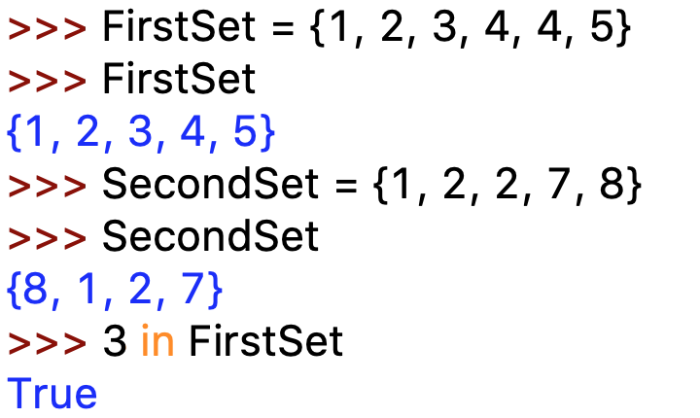
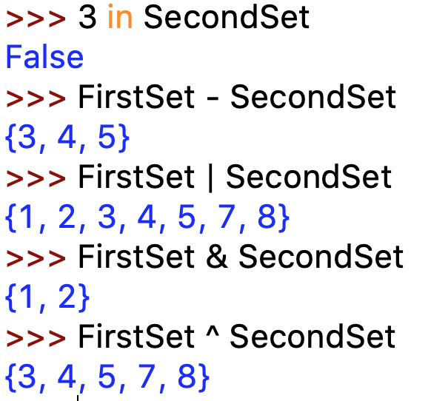
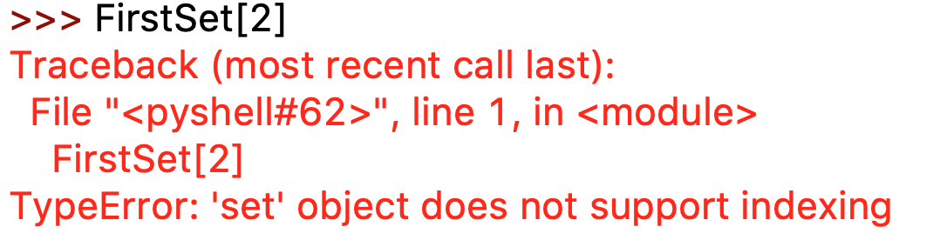
Sets
ignores double
entries
order is irrelevant!
no order - no index

Slide 25
Introduction to Computer Programming Lecture 3.2.e:
Data Structures: Dictionaries
Hemma Philamore
Department of Engineering Mathematics

Slide 26
Learning Objectives
Data Structures
Lists
Tuples
Sets
Dictionary

Slide 27
Dictionary
Dictionaries are unordered sets of data that have a key and a value (an important idea in databases).
key
value
John Doe
+555 7782
Sarah Moor
+555 4039
Mary Salt
+555 9993
Kent Low
+555 1234
Unlike sequences (lists, tuples), which are accessed by numerical indices (0,1,2,3...), dictionaries are indexed by keys.
Keys must be unique and immutable (often numbers or strings).

Slide 28
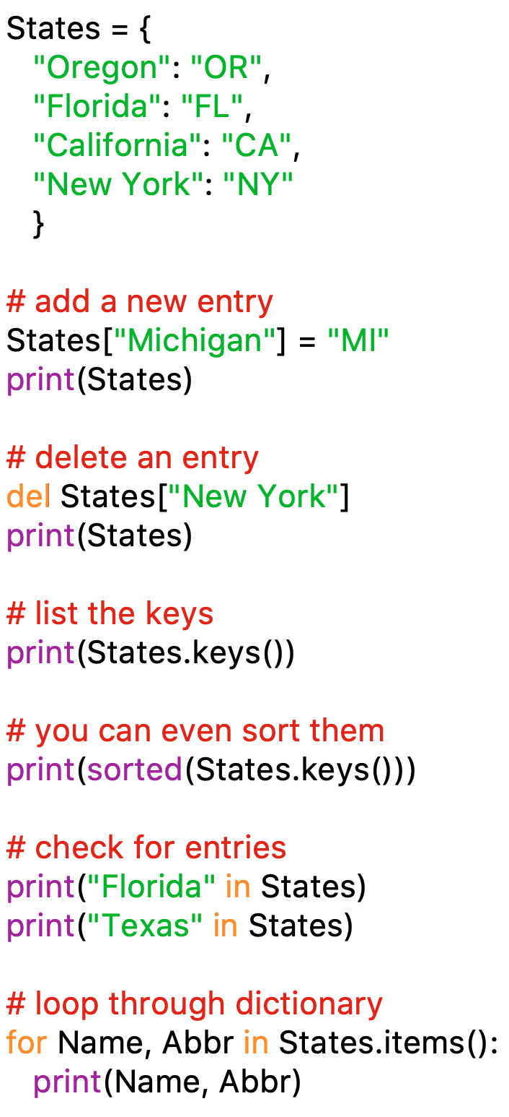
Dictionary
True or False –
can be used for conditions
You get both key
and values

